Slide 1

MIPS Implementation in system verilog
Miguel Ángel Triana Camacho A01228147
Electronic Technologies Integrating Project

Slide 2
Special appreciations
Leonel Haro: My actual manager for teaching me the world of the digital design.
Adrian Navarro: For helping me throughout the career.
Sofia Celis: For giving me moral support.

Slide 3
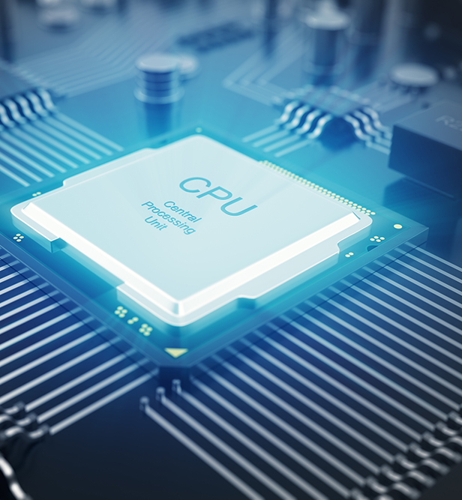
The MIPS ARCHITECTURE…
MIPS (Microprocesor without Interlocked Pipeline Stages) is a RISC architecture of processors developed by MIPS technologies.
There are several versions of the MIPS processor.
MIPS I, II, III, IV, V
This architecture usually uses optional extensions, like floating point SIMDs.
It is a really simple architecture capable of doing a lot of algorithms.
The development of MIPS architecture ended in March of 2021 (More recent than I thought)
It is used in the PlayStation 2!

Slide 4
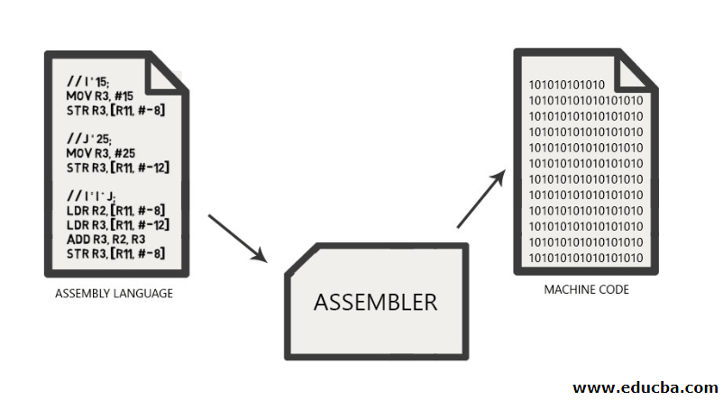
Assembly vs machine code
The lowest level of programming
Consists in one and ceros
The next level is assembly code
Assembly code is the result of the compilation of a high-level language such as:
C
Python
Java
Swift
Perl

Slide 5

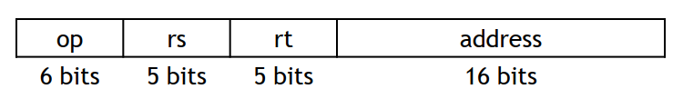

Instruction format
R-TYPE:
op: operation code
rs, rt: first and second source regs
rd: destination reg
shamt: only for shifting
func: used for arithmetic functions
I-TYPE:
op: operation code
rs: source reg
rt: destination reg (source for branches)
address: two’s complement value 16 bits
J-TYPE:
op: operation code
address: positive only value of 26 bits

Slide 6
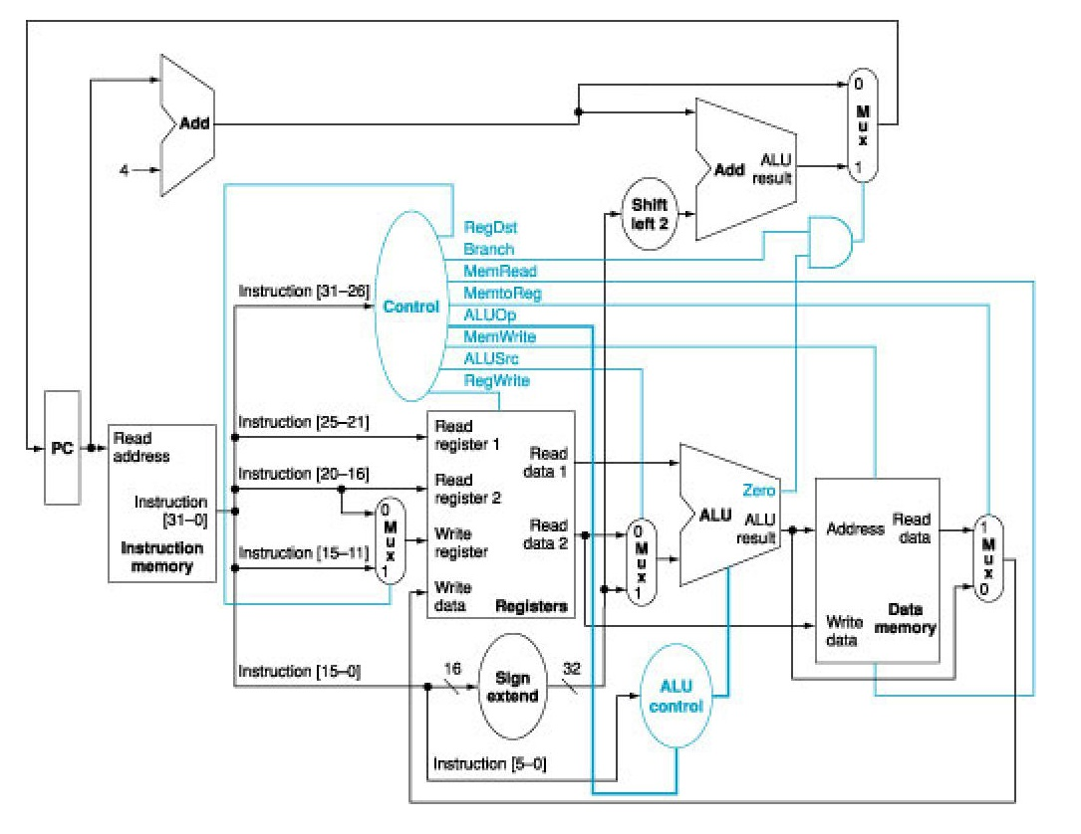
The project implementation…
Single cycle MIPS:
All operations take the same time – One clock cycle.
This design can be improved with pipelining

Slide 7
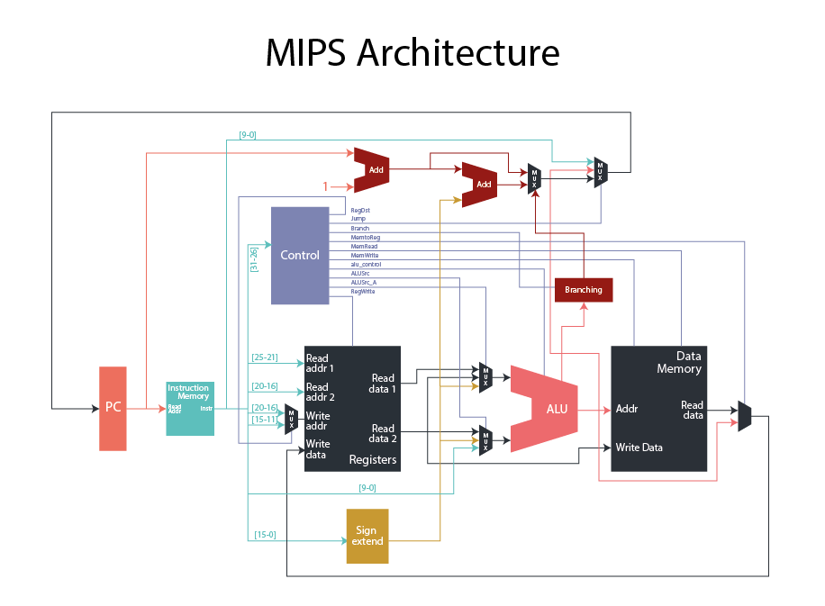
My own modifications…
Added branching block
In order to add BNE, BLTZ, etc.
Added capability of jumping
From PC instruction
From Register Value
Added source mux in the entrance A of the ALU
Extra option in the mux for the entrance in B

Slide 8

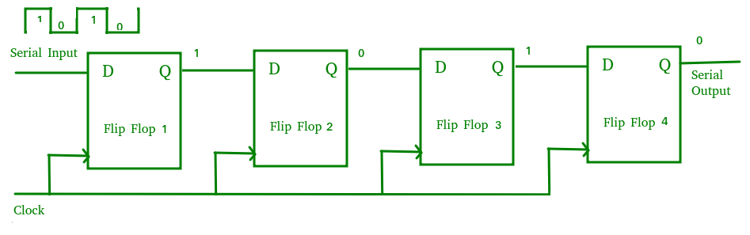
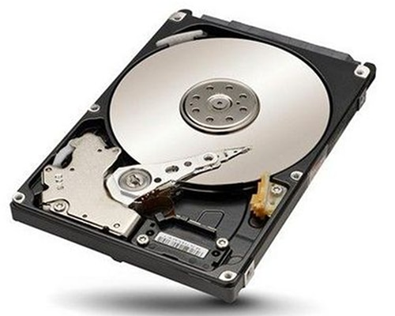
The memories
Three memory types
Instruction Memory
Register bank
Data memory
Where the instructions live
Not runtime writable
Edited by the tb
512 entries
Where all the ‘live’ data lives
Writable, and readable (2 reads at same time)
32 entries
Where the data is stored, it is directly mapped to GPIO
Writable, and readable
1024 entries
GPIO direct mapping

Slide 9
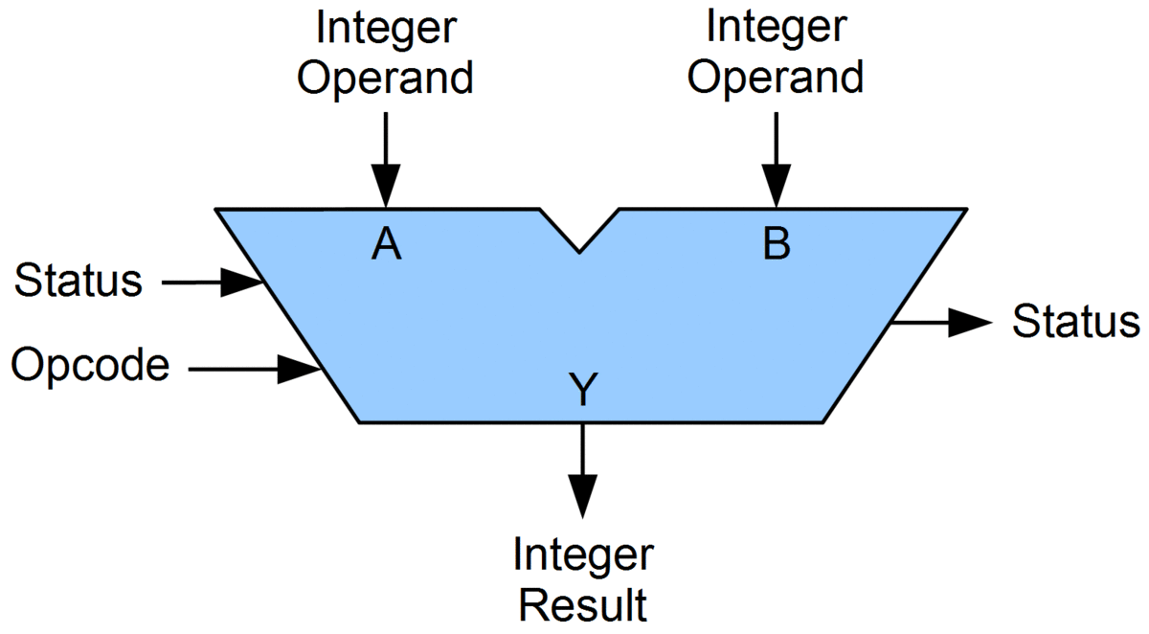
ALU (ARITHMETIC LOGIC UNIT)
Compatible operations:
0) add
1) subtract
2) absolute
3) bypass
4) and
5) or
6) xor
7) set on less than
8) shift right logical
9) shift right arithmetic
10) shift left logical
15) multiplication

Slide 10
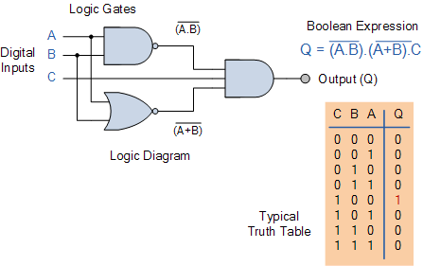

Control unit
operation | opcode | func | RegDst | RegWrite | ALUSrc | alu_control | MemWrite | MemRead | MemToReg | Branch | jump | ALUSrc_A
zero | 6'b000000 | 6'b000000 | 0 | 0 | 0 | 3 | 0 | 0 | 0 | 0 | 0 | 0
ADD | 6'b000000 | 6'b100000 | 1 | 1 | 0 | 0 | 0 | 0 | 0 | 0 | 0 | 0
AND | 6'b000000 | 6'b100100 | 1 | 1 | 0 | 4 | 0 | 0 | 0 | 0 | 0 | 0
MULT | 6'b000000 | 6'b011000 | 1 | 1 | 0 | 15 | 0 | 0 | 0 | 0 | 0 | 0
MULTU | 6'b000000 | 6'b011000 | 1 | 1 | 0 | 15 | 0 | 0 | 0 | 0 | 0 | 0
OR | 6'b000000 | 6'b011000 | 1 | 1 | 0 | 5 | 0 | 0 | 0 | 0 | 0 | 0
SLT | 6'b000000 | 6'b011000 | 1 | 1 | 0 | 7 | 0 | 0 | 0 | 0 | 0 | 0
SUB | 6'b000000 | 6'b011000 | 1 | 1 | 0 | 1 | 0 | 0 | 0 | 0 | 0 | 0
XOR | 6'b000000 | 6'b011000 | 1 | 1 | 0 | 6 | 0 | 0 | 0 | 0 | 0 | 0
SLL | 6'b000000 | 6'b000000 | 1 | 1 | 2 | 10 | 0 | 0 | 0 | 0 | 0 | 1
SRL | 6'b000000 | 6'b000010 | 1 | 1 | 2 | 8 | 0 | 0 | 0 | 0 | 0 | 1
SRA | 6'b000000 | 6'b000010 | 1 | 1 | 2 | 9 | 0 | 0 | 0 | 0 | 0 | 1
ADDI | 6'b001000 |  | 0 | 1 | 1 | 0 | 0 | 0 | 0 | 0 | 0 | 0
ADDIU | 6'b001001 |  | 0 | 1 | 1 | 0 | 0 | 0 | 0 | 0 | 0 | 0
BEQ | 6'b000100 |  | 0 | 0 | 0 | 1 | 0 | 0 | 0 | 1 | 0 | 0
LW | 6'b100011 |  | 0 | 1 | 1 | 0 | 0 | 1 | 1 | 0 | 0 | 0
SW | 6'b101011 |  | 0 | 0 | 1 | 0 | 1 | 0 | 1 | 0 | 0 | 0
JUMP | 6'b000010 |  | 0 | 0 | 0 | 0 | 0 | 0 | 0 | 0 | 1 | 0
ABS | 6'b100001 |  | 0 | 1 | 0 | 2 | 0 | 0 | 0 | 0 | 0 | 0
JR | 6'b001000 |  | 0 | 0 | 0 | 3 | 0 | 0 | 0 | 0 | 2 | 0
BNE | 6'b000101 |  | 0 | 0 | 0 | 1 | 0 | 0 | 0 | 2 | 0 | 0
BGEZ | 6'b000001 |  | 0 | 0 | 0 | 1 | 0 | 0 | 0 | 3 | 0 | 0
BGTZ | 6'b000111 |  | 0 | 0 | 0 | 1 | 0 | 0 | 0 | 4 | 0 | 0
ANDI | 6'b001100 |  | 0 | 1 | 1 | 4 | 0 | 0 | 0 | 0 | 0 | 0
ORI | 6'b001101 |  | 0 | 1 | 1 | 5 | 0 | 0 | 0 | 0 | 0 | 0
XORI | 6'b001110 |  | 0 | 1 | 1 | 6 | 0 | 0 | 0 | 0 | 0 | 0
LUI | 6'b001111 |  | 0 | 1 | 0 | 3 | 0 | 0 | 0 | 0 | 0 | 2
Notes:
The brains of the micro, without this it can not simply work

Slide 11
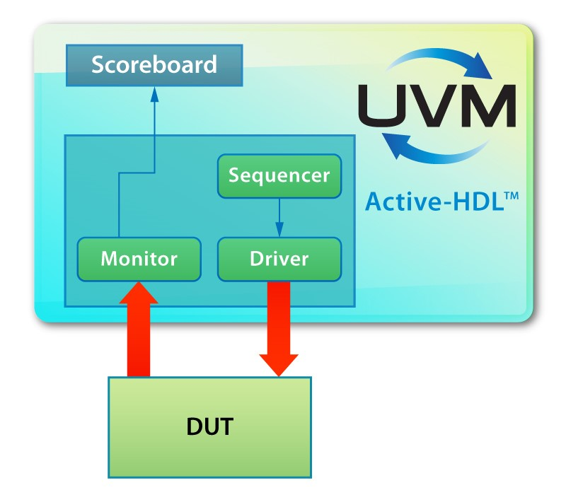
Validation… the secret for perfection
This step is almost always minimized
50% Design -- 50% Verification
Normally it is done through scoreboards and checkers
For this project it was done with visual inspection
This can lead to errors that are not easily seen

Slide 12
The tb… let’s prove some basic testing
module MIPS_tb_basic_testing ();
logic clk;
logic rst;
integer i;
integer j;
MIPS uut(.clk(clk), .rst(rst));
initial begin
//reset when startup
rst = 1;
clk = 0;
#20; //wait
rst = 0;
#10; //wait
//data memory load
uut.i_DataMemory.regData[0] = 0;
uut.i_DataMemory.regData[1] = 10;
uut.i_DataMemory.regData[10] = 250;
uut.i_DataMemory.regData[20] = 20;
uut.i_RegBank.RegBank[0] = 0;
uut.i_RegBank.RegBank[1] = 10;
uut.i_RegBank.RegBank[2] = 9;
uut.i_RegBank.RegBank[20] = 20;
uut.i_RegBank.RegBank[31] = -20;
#10; //wait
//Instruction load
uut.i_InstructionMemory.regData[0] = 0;
uut.i_InstructionMemory.regData[1] = 32'b00000000001000101000000000100000; //ADD
uut.i_InstructionMemory.regData[2] = 32'b00000000001000100001100000100101; //OR
uut.i_InstructionMemory.regData[3] = 32'b00000000010000010010000000101010; //SLT
uut.i_InstructionMemory.regData[4] = 32'b00000000001000100010100000100010; //SUB
uut.i_InstructionMemory.regData[5] = 32'b00000000001000100011000000100110; //XOR
uut.i_InstructionMemory.regData[6] = 32'b00000000000000010011100010000000; //SLL
uut.i_InstructionMemory.regData[7] = 32'b00000000000000010100000010000010; //SRL
uut.i_InstructionMemory.regData[8] = 32'b00000000000111110100100010000011; //SRA
uut.i_InstructionMemory.regData[9] = 32'b10000111111000000101000000000000; //ABS
uut.i_InstructionMemory.regData[10] = 32'b00100000001010110000000000001111; //ADDI
uut.i_InstructionMemory.regData[11] = 32'b00100100001011000000000000010000; //ADDIU
uut.i_InstructionMemory.regData[12] = 32'b00110000010011010000000000000010; //ANDI
uut.i_InstructionMemory.regData[13] = 32'b00110100010011100000000000000011; //ORI
uut.i_InstructionMemory.regData[14] = 32'b00111000010011110000000000000111; //XORI
uut.i_InstructionMemory.regData[15] = 32'b00010000001000100000000000000000; //BEQ 0
uut.i_InstructionMemory.regData[16] = 32'b10001100001100110000000000000000; //LW
uut.i_InstructionMemory.regData[17] = 32'b10101100001101000000000000000000; //SW
uut.i_InstructionMemory.regData[18] = 32'b00000010100000000000000000001000; //JR
uut.i_InstructionMemory.regData[20] = 32'b00000000001000101000000000011000; //MUL
uut.i_InstructionMemory.regData[21] = 32'b00010000101001000000000000000010; //BEQ 1
uut.i_InstructionMemory.regData[23] = 32'b00010100101001000000000000010111; //BNE 0
uut.i_InstructionMemory.regData[24] = 32'b00010100101000010000000000000010; //BNE 1
uut.i_InstructionMemory.regData[31] = 32'b00001000000000000000000000000001; //J
end
initial begin
forever #5 clk = ~clk; //clk generation
end
endmodule
Notes:
We can see the code of the TB. This code is in charge of reseting the design, and loading the data in both instruction memory, and data memory. Normally the registers won’t be precharged, but we will do it for testing purposes.

Slide 13
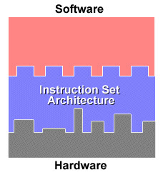
Second look at the instructions
r-type OP S T D SH FUNC
ADD 000000 00001 00010 10000 00000 100000
OR 000000 00001 00010 00011 00000 100101
SLT 000000 00010 00001 00100 00000 101010
SUB 000000 00001 00010 00101 00000 100010
XOR 000000 00001 00010 00110 00000 100110
SLL 000000 00000 00001 00111 00010 000000
SRL 000000 00000 00001 01000 00010 000010
SRA 000000 00000 11111 01001 00010 000011
ABS 100001 11111 00000 01010 00000 000000
i-type OP S T ADDR
ADDI 001000 00001 01011 0000000000001111
ADDIU 001001 00001 01100 0000000000010000
ANDI 001100 00010 01101 0000000000000010
ORI 001101 00010 01110 0000000000000011
XORI 001110 00010 01111 0000000000000111
BEQ 000100 00001 00010 0000000000000000
LW 100011 00001 10011 0000000000000000
SW 101011 00001 10100 0000000000000000
JR 000000 10100 00000 0000000000001000
r-type OP S T D SH FUNC MUL 000000 00001 00010 10000 00000 011000
i-type OP S T ADDR
BEQ 000100 00101 00100 0000000000000010
BNE 000101 00101 00100 0000000000010111
BNE 000101 00101 00001 0000000000000010
j-type OP ADDR
J 000010 00000000000000000000000001
ADD $16, $1, $2 $16 = $1 + $2
OR $3, $1, $2 $3 = $1 | $2
SLT $4, $2, $1 if ($2 < $1) $4 = 1
SUB $5, $1, $2 $5 = $1 - $2
XOR $6, $1, $2 $6 = $1 ^ $2
SLL $7, $1, 2 $7 = $1 << 2
SRL $8, $1, 2 $8 = $1 >> 2
SRA $9, $1, 2 $9 = $31 >>> 2
ABS $10, $30 $10 = abs($30)
ADDI $11, $1, 15 $11 = $1 + 15
ADDIU $12, $1, 16 $12 = $1 + 16
ANDI $13, $2, 2 $13 = $2 & 2
ORI $14, $2, 3 $14 = $2 | 3
XORI $15, $2, 7 $15 = $2 ^ 7
BEQ $2, $1, 0 if ($2 == $1) pc + 0
LW $19, 0($1) $19 = MEM[$19 + 0]
SW $20, 0($1) MEM[$1 + 0] = $20
JR $20 jump to value in $20
MUL $16, $1, $2 $16 = $1 * $2
BEQ $5, $4, 2 if ($5 == $4) pc + 2
BNE $5, $4, 23 if ($5 != $4) pc + 23
BNE $5, $4, 2 if ($5 != $4) pc + 2
J 1 jump to address offset

Slide 14
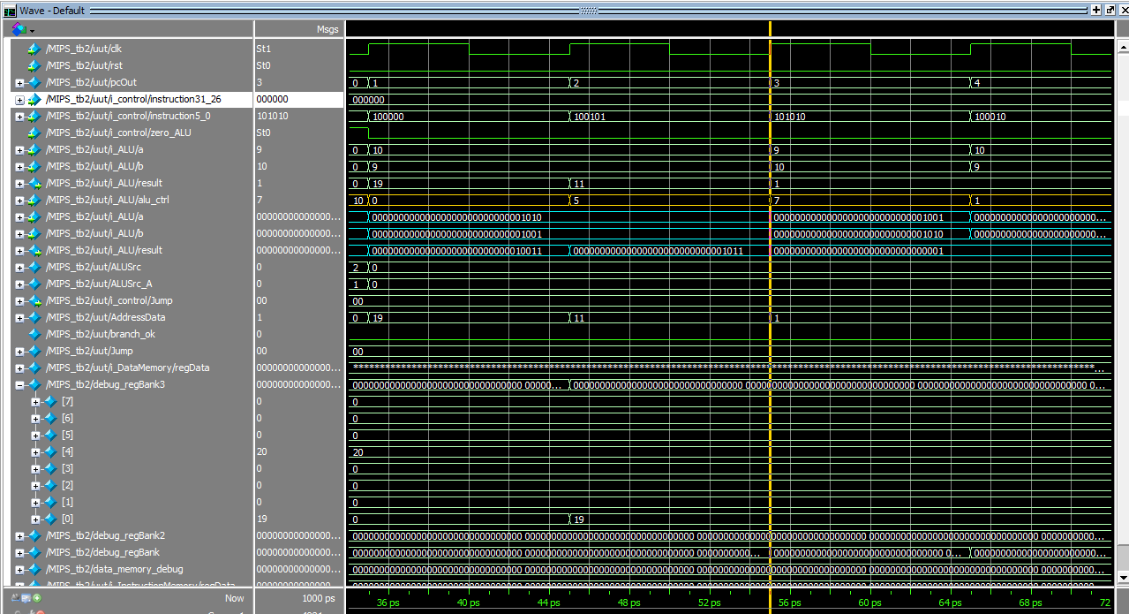

Slide 15
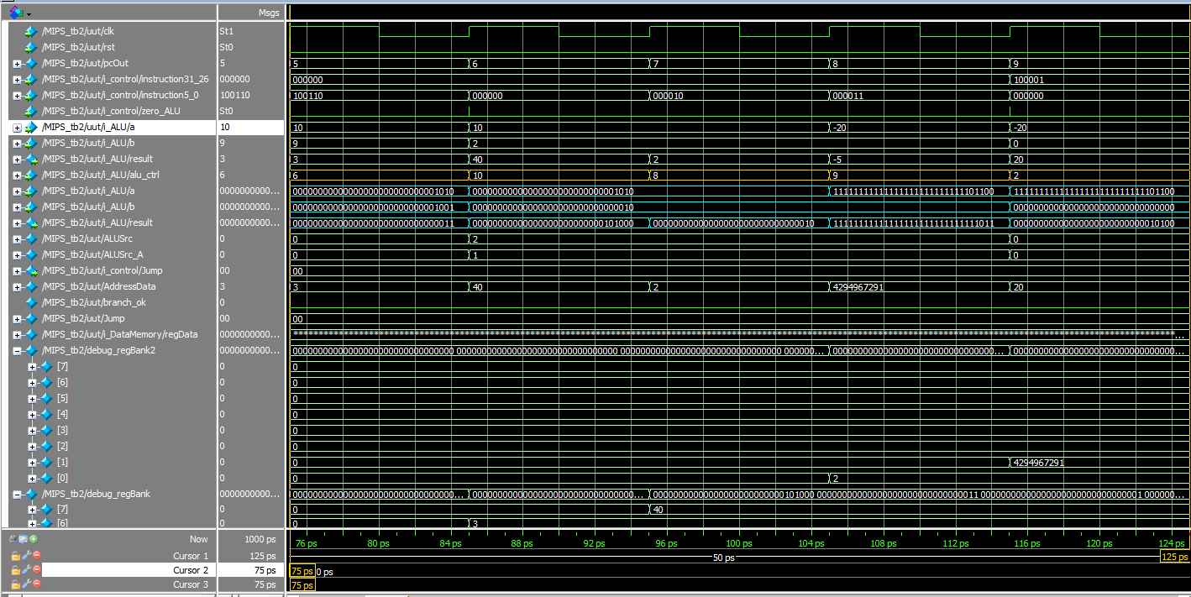

Slide 16
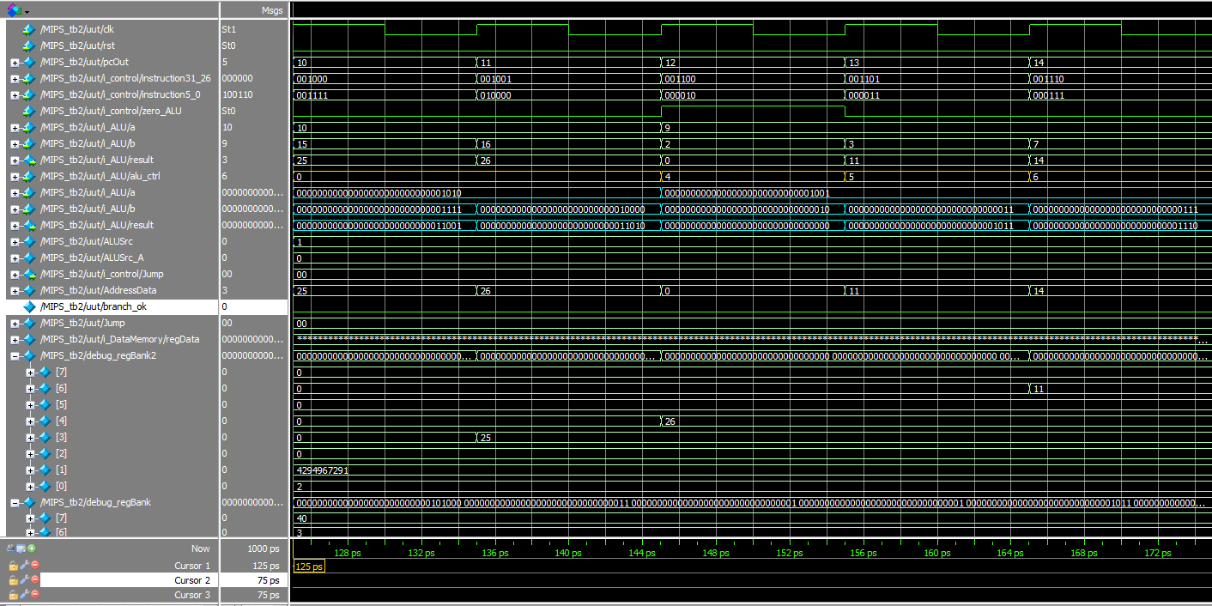

Slide 17
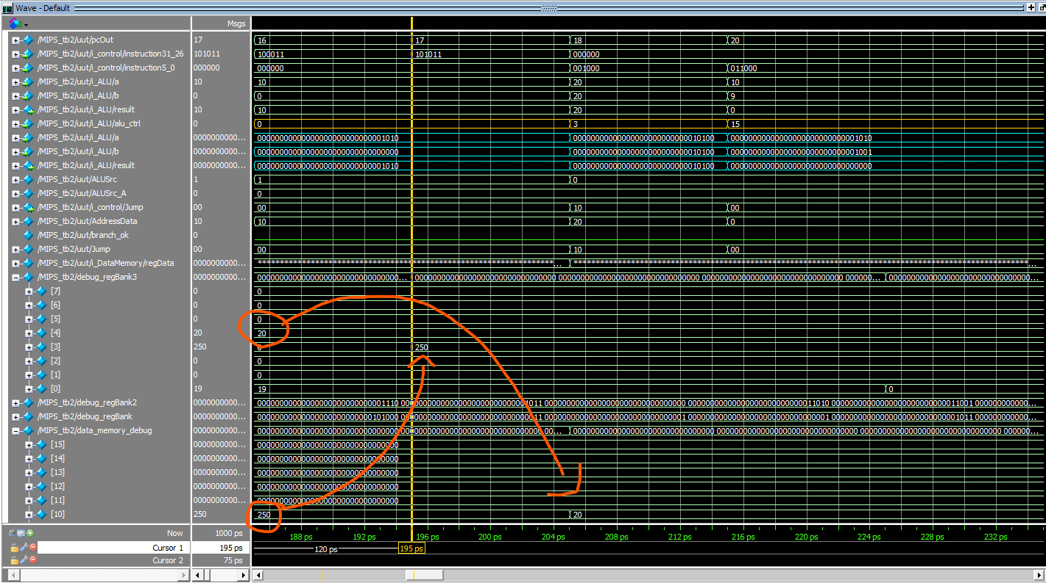

Slide 18
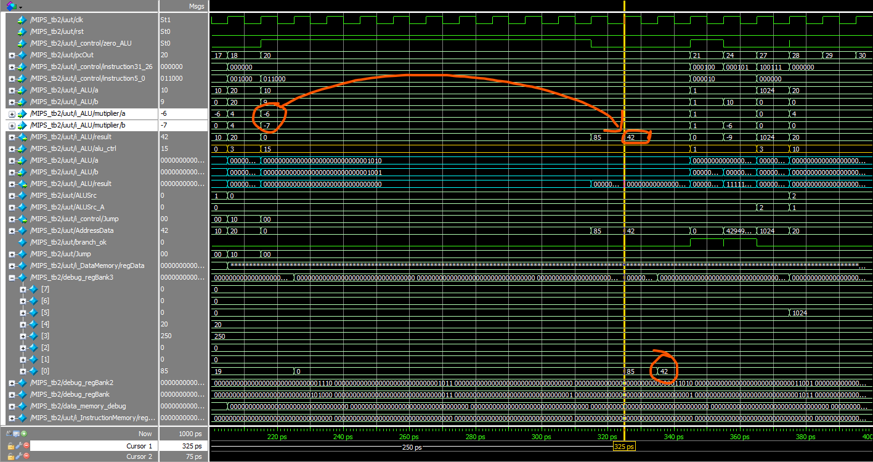

Slide 19
NOW THAT WE KNOW IT WORKS…
ADD 000000 00000 00000 00110 00000 100000
ADD 000000 00000 00000 00001 00000 100000
ADDI 001000 00000 00010 0000000000001010
LW 100011 00001 00011 0000000000000000
LW 100011 00001 00100 0000000000000001
SLT 000000 00100 00011 00100 00000 101010
BEQ 000100 00101 00000 0000000000000010
SW 101011 00001 00011 0000000000000001
SW 101011 00001 00100 0000000000000000
ADDI 001000 00001 00001 0000000000000001
OR 000000 00101 00110 00110 00000 100101
BEQ 000100 00001 00010 0000000000000001
J 000010 00000000000000000000000100
BEQ 000100 00110 00000 0000000000000001
J 000010 00000000000000000000000001
J 000010 00000000000000000000001110
uut.i_InstructionMemory.regData[0] = 32'b00000000000000000011000000100000;
uut.i_InstructionMemory.regData[1] = 32'b00000000000000000000100000100000; //START1
uut.i_InstructionMemory.regData[2] = 32'b00100000000000100000000000001010; //ADDI
uut.i_InstructionMemory.regData[3] = 32'b10001100001000110000000000000000; //LW LOOP 3
uut.i_InstructionMemory.regData[4] = 32'b10001100001001000000000000000001; //LW
uut.i_InstructionMemory.regData[5] = 32'b00000000100000110010100000101010; //SLT
uut.i_InstructionMemory.regData[6] = 32'b00010000101000000000000000000010; //BEQ
uut.i_InstructionMemory.regData[7] = 32'b10101100001000110000000000000001; //SW
uut.i_InstructionMemory.regData[8] = 32'b10101100001001000000000000000000; //SW
uut.i_InstructionMemory.regData[9] = 32'b00100000001000010000000000000001; //ADDI
uut.i_InstructionMemory.regData[10] = 32'b00000000101001100011000000100101; //OR
uut.i_InstructionMemory.regData[11] = 32'b00010000001000100000000000000001; //BEQ
uut.i_InstructionMemory.regData[12] = 32'b00001000000000000000000000000011; //JUMP LOOP 3
uut.i_InstructionMemory.regData[13] = 32'b00010000110000000000000000000001; //BEQ
uut.i_InstructionMemory.regData[14] = 32'b00001000000000000000000000000000; //JUMP START 0
uut.i_InstructionMemory.regData[15] = 32'b0;
uut.i_InstructionMemory.regData[16] = 32'b0;
uut.i_InstructionMemory.regData[17] = 32'b00001000000000000000000000010001; //START1
uut.i_InstructionMemory.regData[18] = 0;
uut.i_InstructionMemory.regData[19] = 0;
uut.i_InstructionMemory.regData[21] = 0;

Slide 20
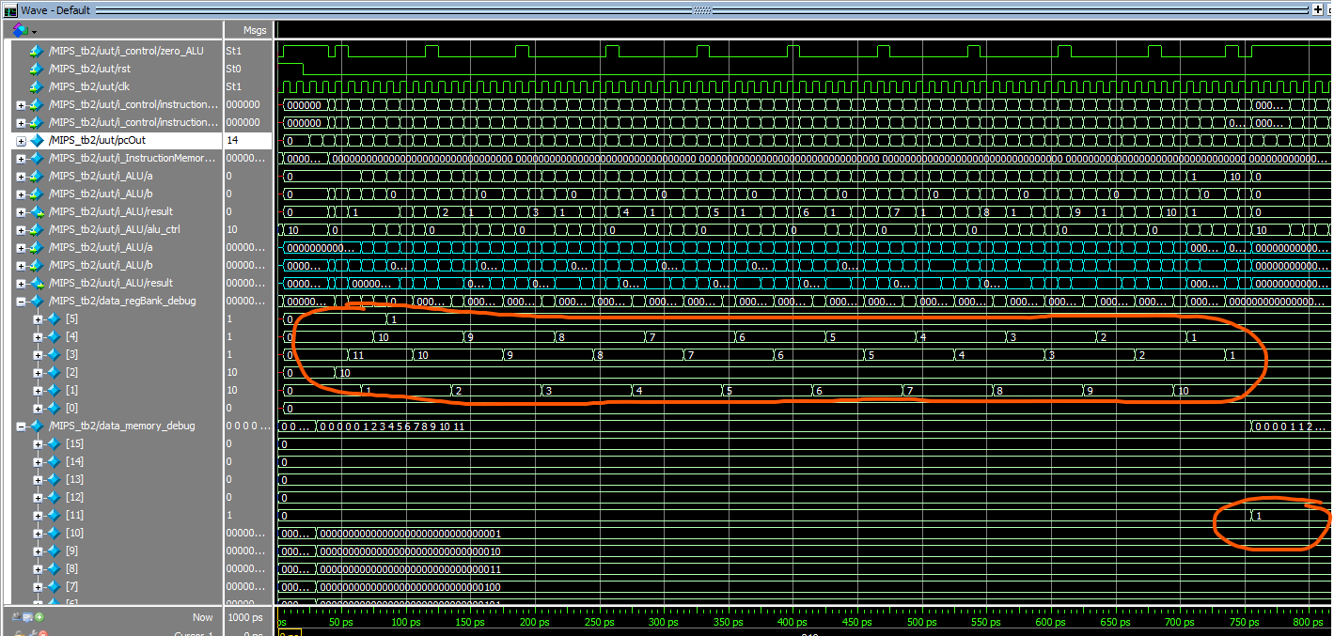

Slide 21
The unmatched bubble sort
ADD $6, $0, $0 //UNSET OR FLAG
ADD $1, $0, $0 //START POINTER OF THE ARRAY (0)
ADDI $2, $0, 10 //END POINTER OF THE ARRAY
LW $3, 0($1) //READ POINTED VALUE OF THE ARRAY
LW $4, 1($1) //READ POINTED VALUE OF THE ARRAY PLUS ONE
SLT $5, $4, $3 //CHECK IF THE FIRST VALUE IS HIGHER THAN THE SECOND
BEQ $5, $0, 2 //IF IT IS LOWER THAN THE SECOND, LEAVE THEM AS THEY ARE
SW $3, 0($1) //IF IT IS HIGHER, SWAP THE ORDER OF THE VALUES
SW $4, 1($1)
ADDI $1, $1, 1 //INCREMENT POINTER
OR $6, $6, $5 //CHECK IF THERE HAS BEEN A CHANGE DONE IN THE ITERATION
BEQ $1, $2, 1 //IF WE REACH THE FINAL VALUE OF THE POINTER, EXIT THE LOOP
J 3 //IF FINAL VALUE IS NOT REACHED, STAY IN LOOP
BEQ $6, $0, 1 //IF THERE HAS NOT BEEN A CHANGE DONE IN THE ARRAY RUN, EXIT THE LOOP
JUMP 0 //IF THERE HAS BEEN A CHANGE DONE IN THE ARRAY RUN, REPEAT THE PROGRAM
JUMP 17 //STAY IN THESE INSTRUCTION

Slide 22
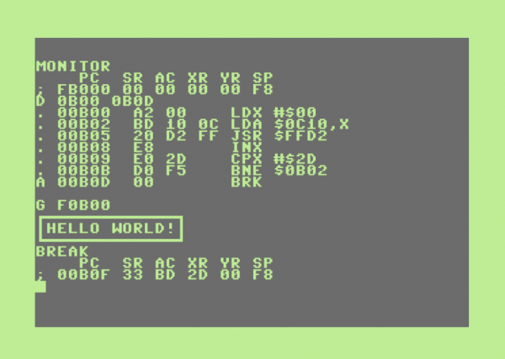
The data in the instruction memory
uut.i_InstructionMemory.regData[0] = 32'b00000000000000000011000000100000;
uut.i_InstructionMemory.regData[1] = 32'b00000000000000000000100000100000; //START1
uut.i_InstructionMemory.regData[2] = 32'b00100000000000100000000000001010; //ADDI
uut.i_InstructionMemory.regData[3] = 32'b10001100001000110000000000000000; //LW LOOP 3
uut.i_InstructionMemory.regData[4] = 32'b10001100001001000000000000000001; //LW
uut.i_InstructionMemory.regData[5] = 32'b00000000100000110010100000101010; //SLT
uut.i_InstructionMemory.regData[6] = 32'b00010000101000000000000000000010; //BEQ
uut.i_InstructionMemory.regData[7] = 32'b10101100001000110000000000000001; //SW
uut.i_InstructionMemory.regData[8] = 32'b10101100001001000000000000000000; //SW
uut.i_InstructionMemory.regData[9] = 32'b00100000001000010000000000000001; //ADDI
uut.i_InstructionMemory.regData[10] = 32'b00000000101001100011000000100101; //OR
uut.i_InstructionMemory.regData[11] = 32'b00010000001000100000000000000001; //BEQ
uut.i_InstructionMemory.regData[12] = 32'b00001000000000000000000000000011; //JUMP LOOP 3
uut.i_InstructionMemory.regData[13] = 32'b00010000110000000000000000000001; //BEQ
uut.i_InstructionMemory.regData[14] = 32'b00001000000000000000000000000000; //JUMP START 0
uut.i_InstructionMemory.regData[15] = 32'b0;
uut.i_InstructionMemory.regData[16] = 32'b0;
uut.i_InstructionMemory.regData[17] = 32'b00001000000000000000000000010001; //START1
uut.i_InstructionMemory.regData[18] = 0;
uut.i_InstructionMemory.regData[19] = 0;
uut.i_InstructionMemory.regData[21] = 0;

Slide 23
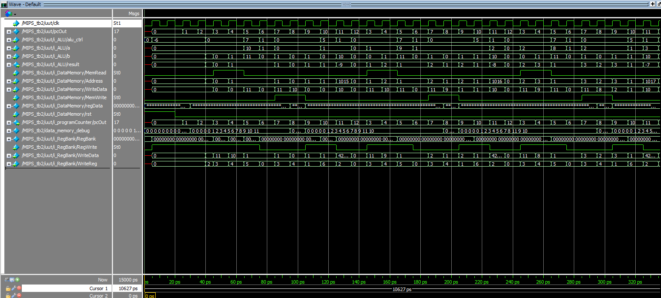

Slide 24
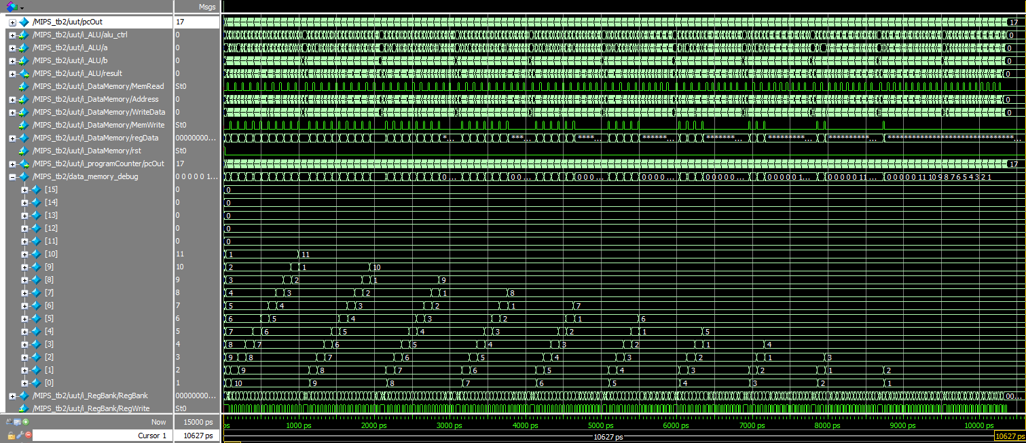

Slide 25
Thank you
GOODBYE

Slide 26
SOURCES
Digital Systems Course by Leonel Haro in Tecnologico de Monterrey
Christensson, P. (2019, January 18). Machine Language Definition. Retrieved 2021, Jun 10, from https://techterms.com
Clifford, C. E. (2003). Synthesizable Finite State Machine Design TechniquesUsing the New SystemVerilog 3.0 Enhancements. San Jose ; Sunburst Design, Inc.
s. (n.d.). Machine Language. Machine Language Definition. https://techterms.com/definition/machine_language.
Texas Instruments. (n.d.). Cortex-M3/M4F Instruction Set. ARM Developer. http://users.ece.utexas.edu/~valvano/EE345L/Labs/Fall2011/CortexM_InstructionSet.pdf.
University of Idaho. (n.d.). MIPS Instruction Reference. Idaho; University of Idaho.
University of Idaho. (n.d.). MIPS R3000 Instruction Set Summary. Idaho; University of Idaho.
Vahid, F. (2010). Digital design: with Rtl design, Vhdl, and Verilog. Wiley-Blackwell.

